Slide 1
Where's Waldo? Finder
presented by Youssef Beltagy and Nathan Pham

Slide 2
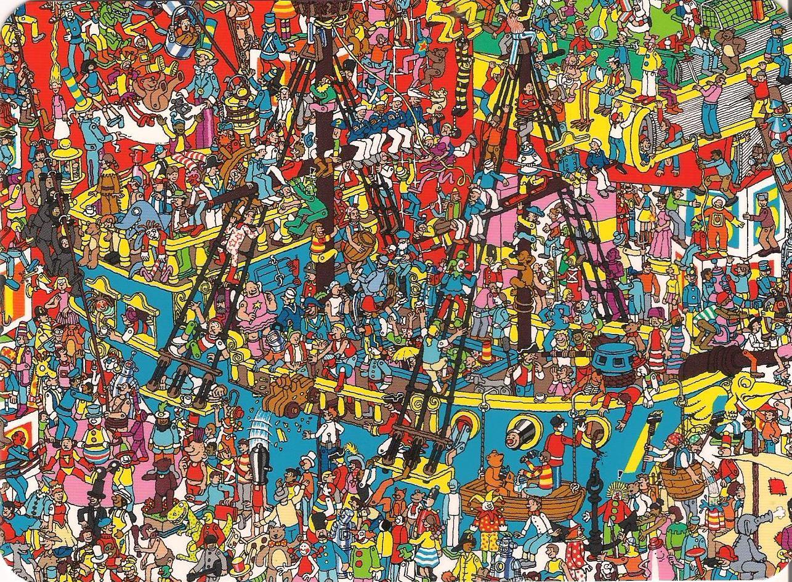
Problem Statement
Find Waldo in a given world, given an example image of Waldo
Success Criteria:
The location of waldo in an image
Display the most likely location of Waldo
Challenge: Waldo's face is distorted
Project Goals:
Feasible
Test a variety of algorithms
No machine learning
Compare if we have time
Apply as much as we learned in the course

Slide 3
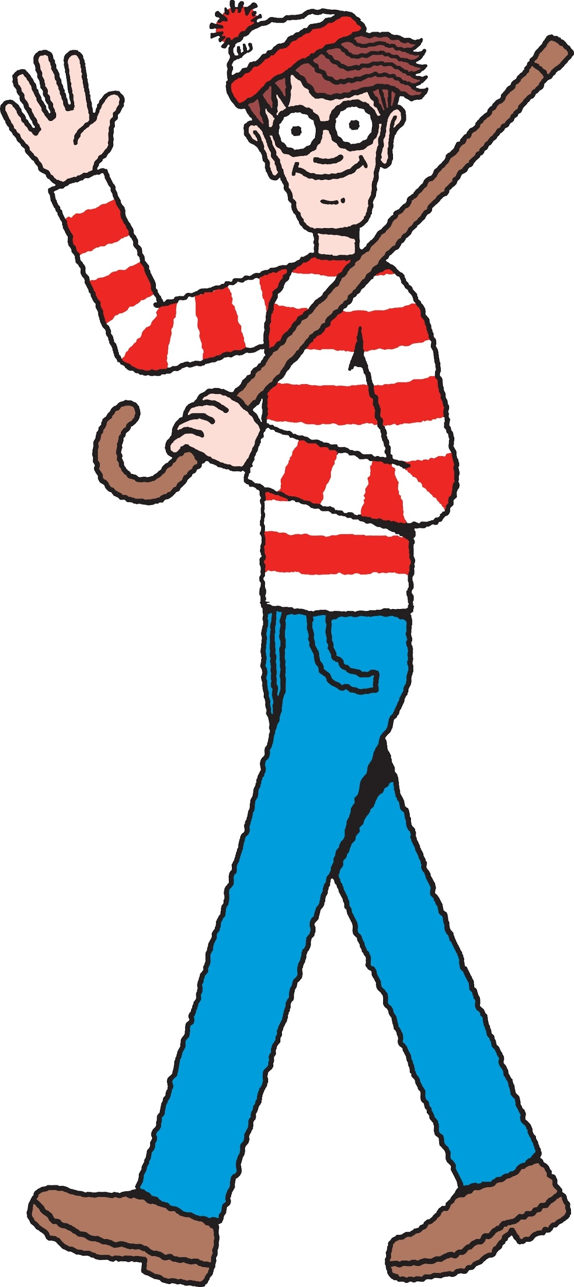
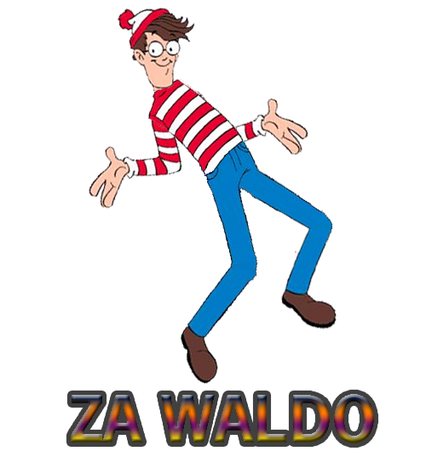
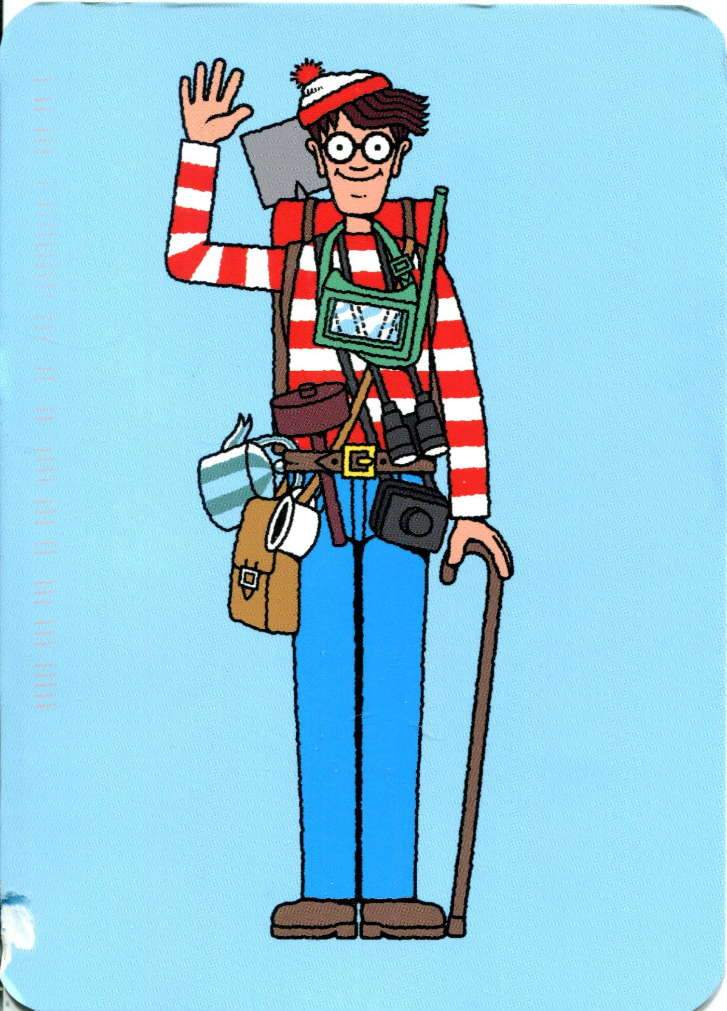
Motivation & Merits
Challenging problem
Template Matching won't work. Waldo is often distorted
Waldo is often occluded
New Waldos: Added hiking gear
Old Waldos: torso is often hidden
Waldo's entire body is often in the tens of pixels wide and long
Can be very grainy
Key features of Waldo not guaranteed
Worst case: World Waldo has one key feature
Which example key feature will match?

Slide 4
Failed Methodologies
SIFT
Not discriminative enough
SIFT for each RGB Channel + Gray with Clustering

Slide 5
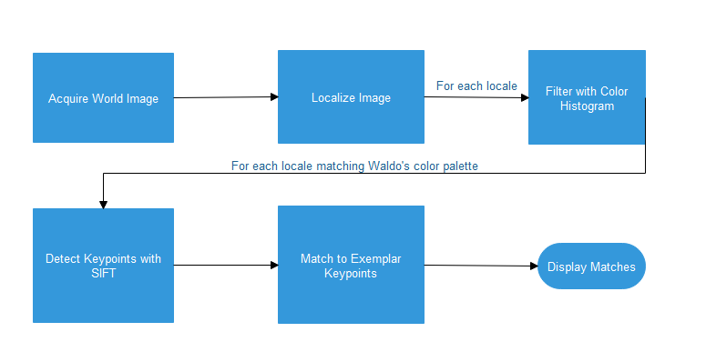
General Pipeline Methodology

Slide 6
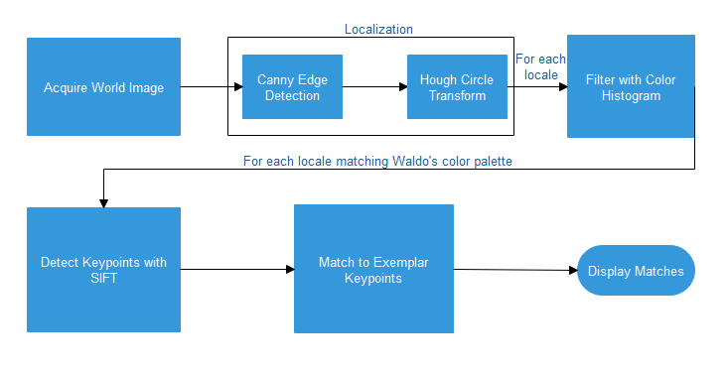
Method 1: Hough Circle Localization
Matching:
Top 50 exemplar keypoints
For each keypoint , display top 50 matches
For sure: One match if Waldo exists

Slide 7
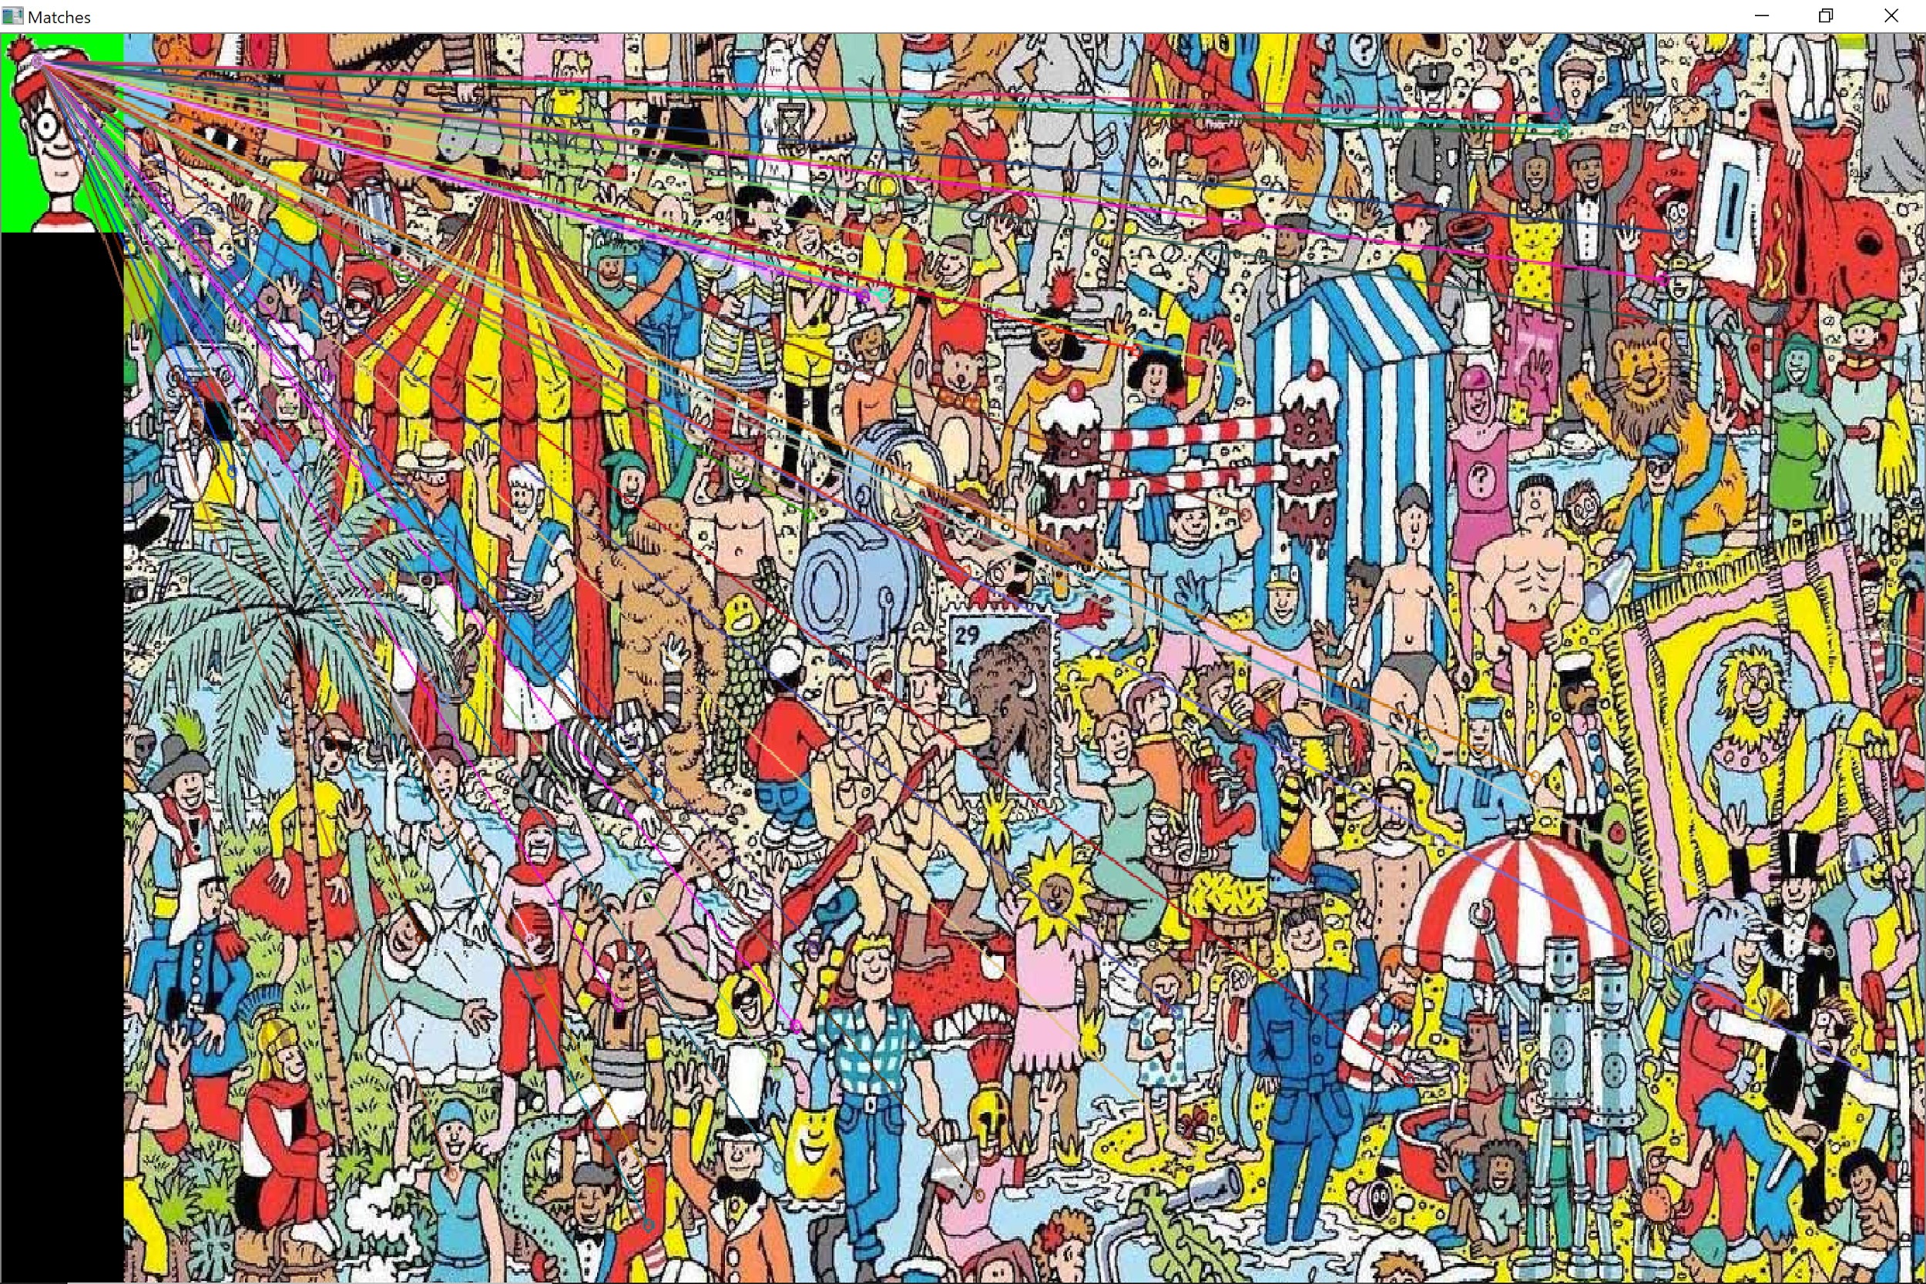
Method 1: Results
Waldo mapped in 6 out of 10 maps

Slide 8
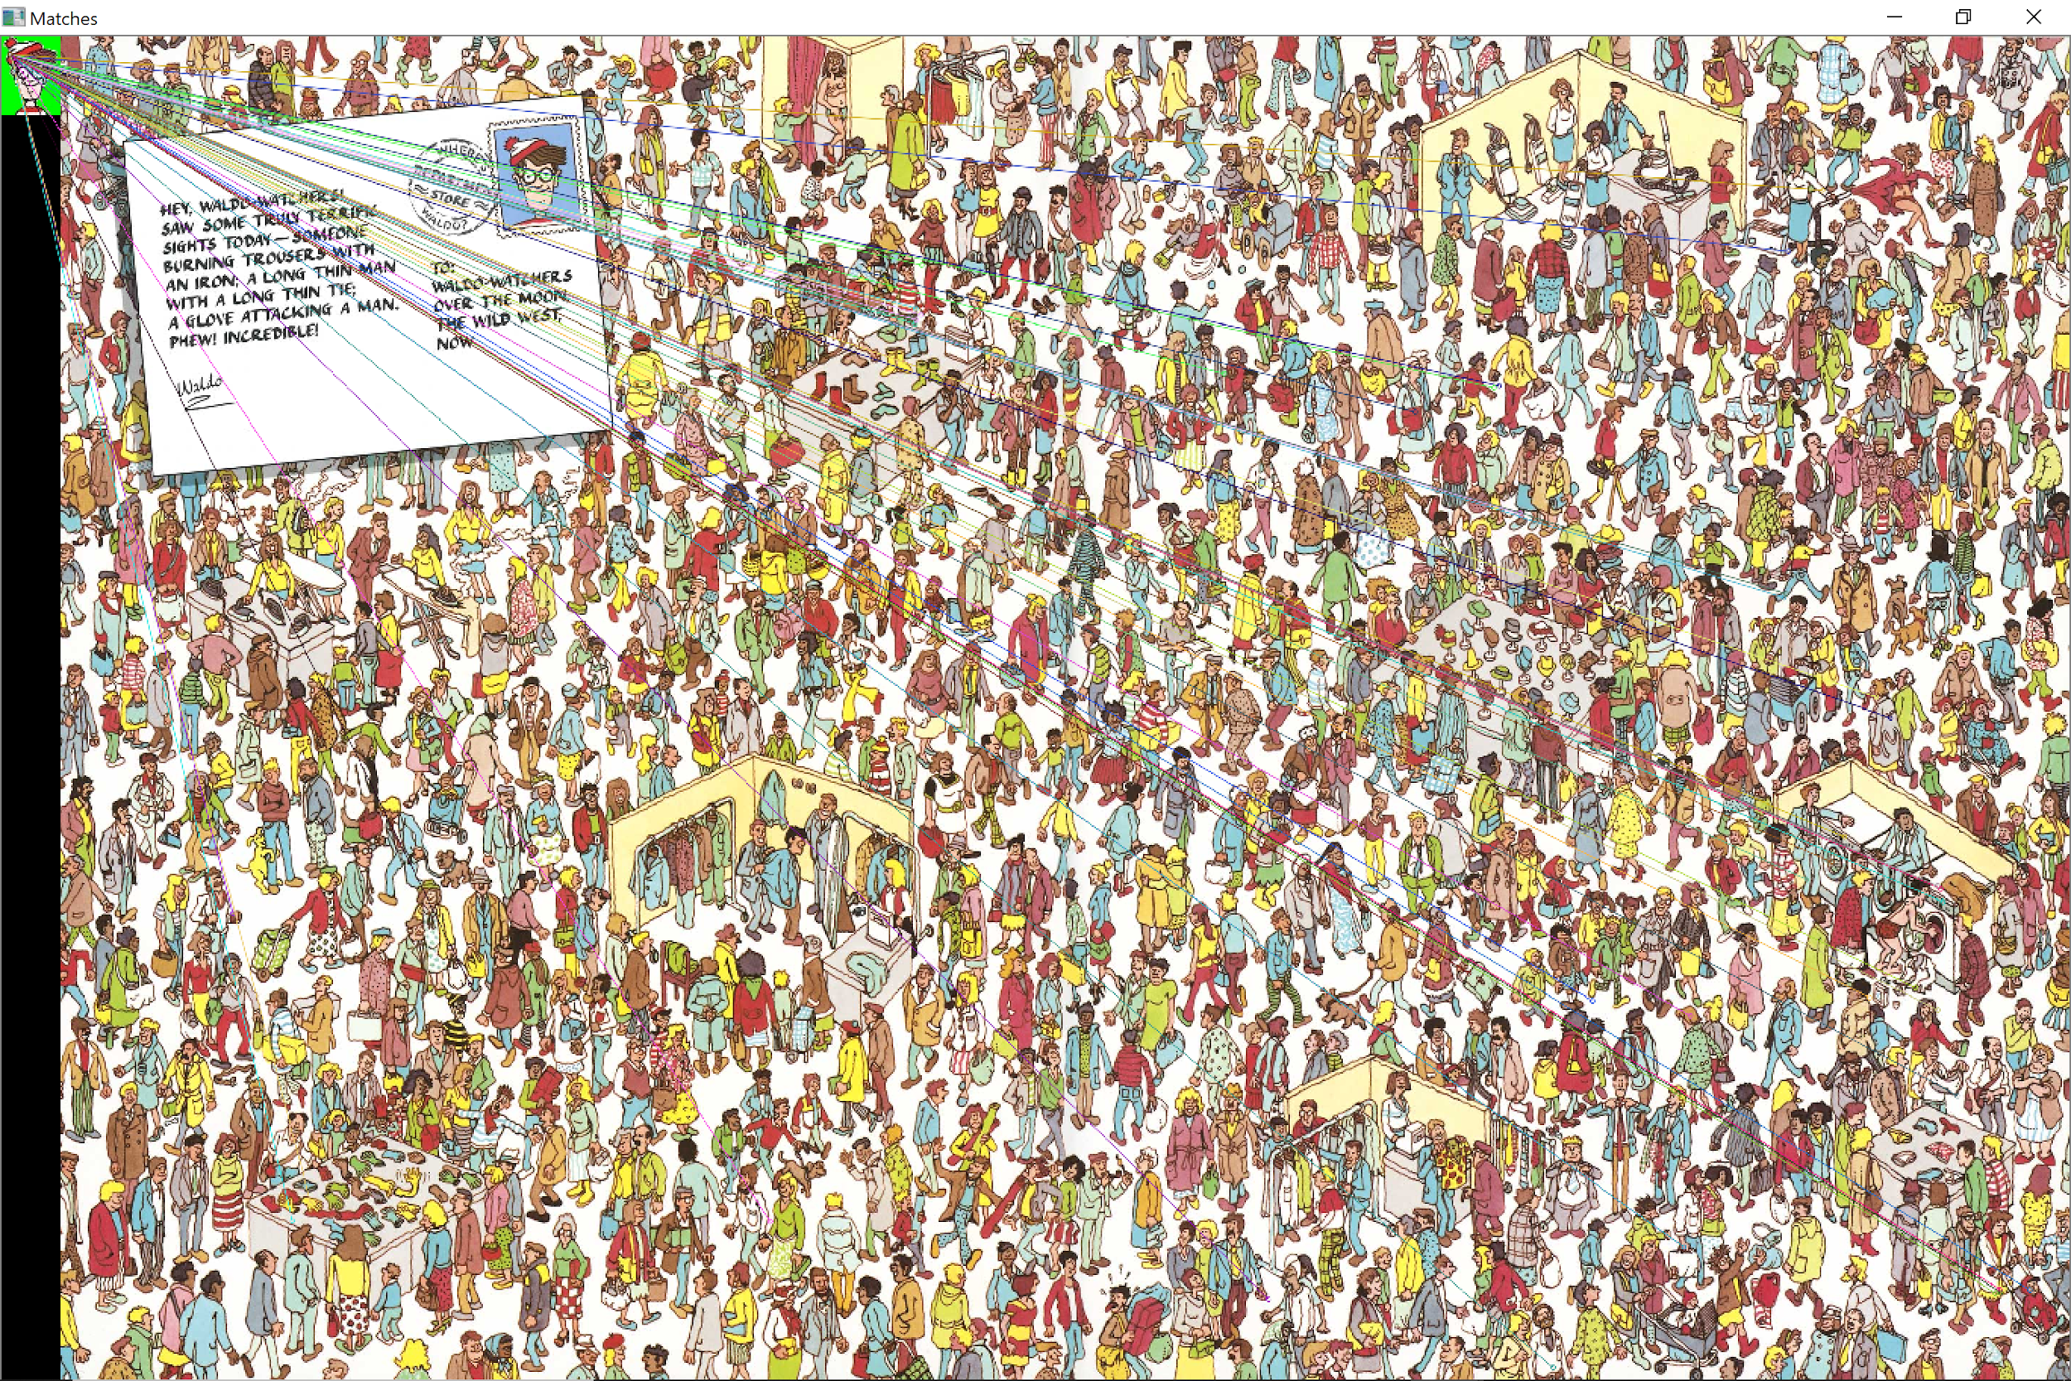
Method 1: Results
Waldo mapped in 6 out of 10 maps

Slide 9
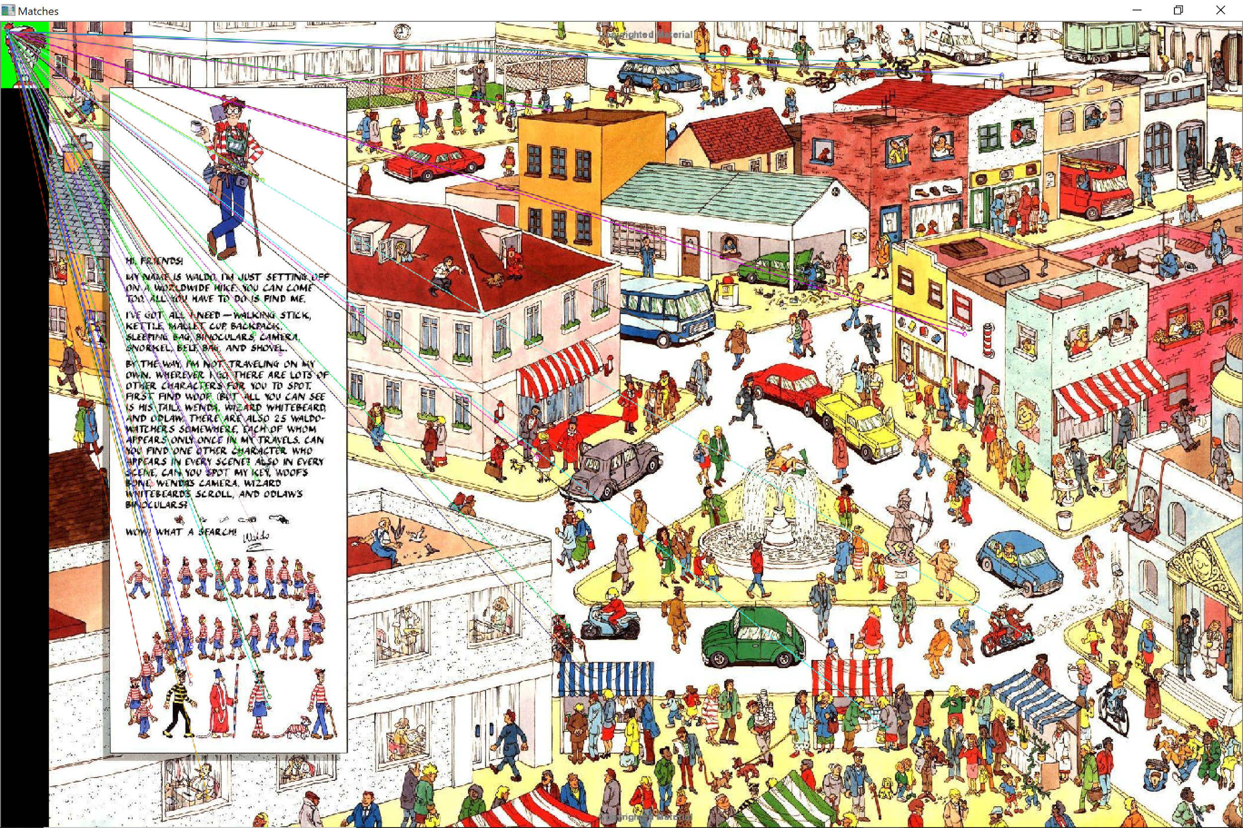
Method 1: Results
Waldo mapped in 6 out of 10 maps

Slide 10
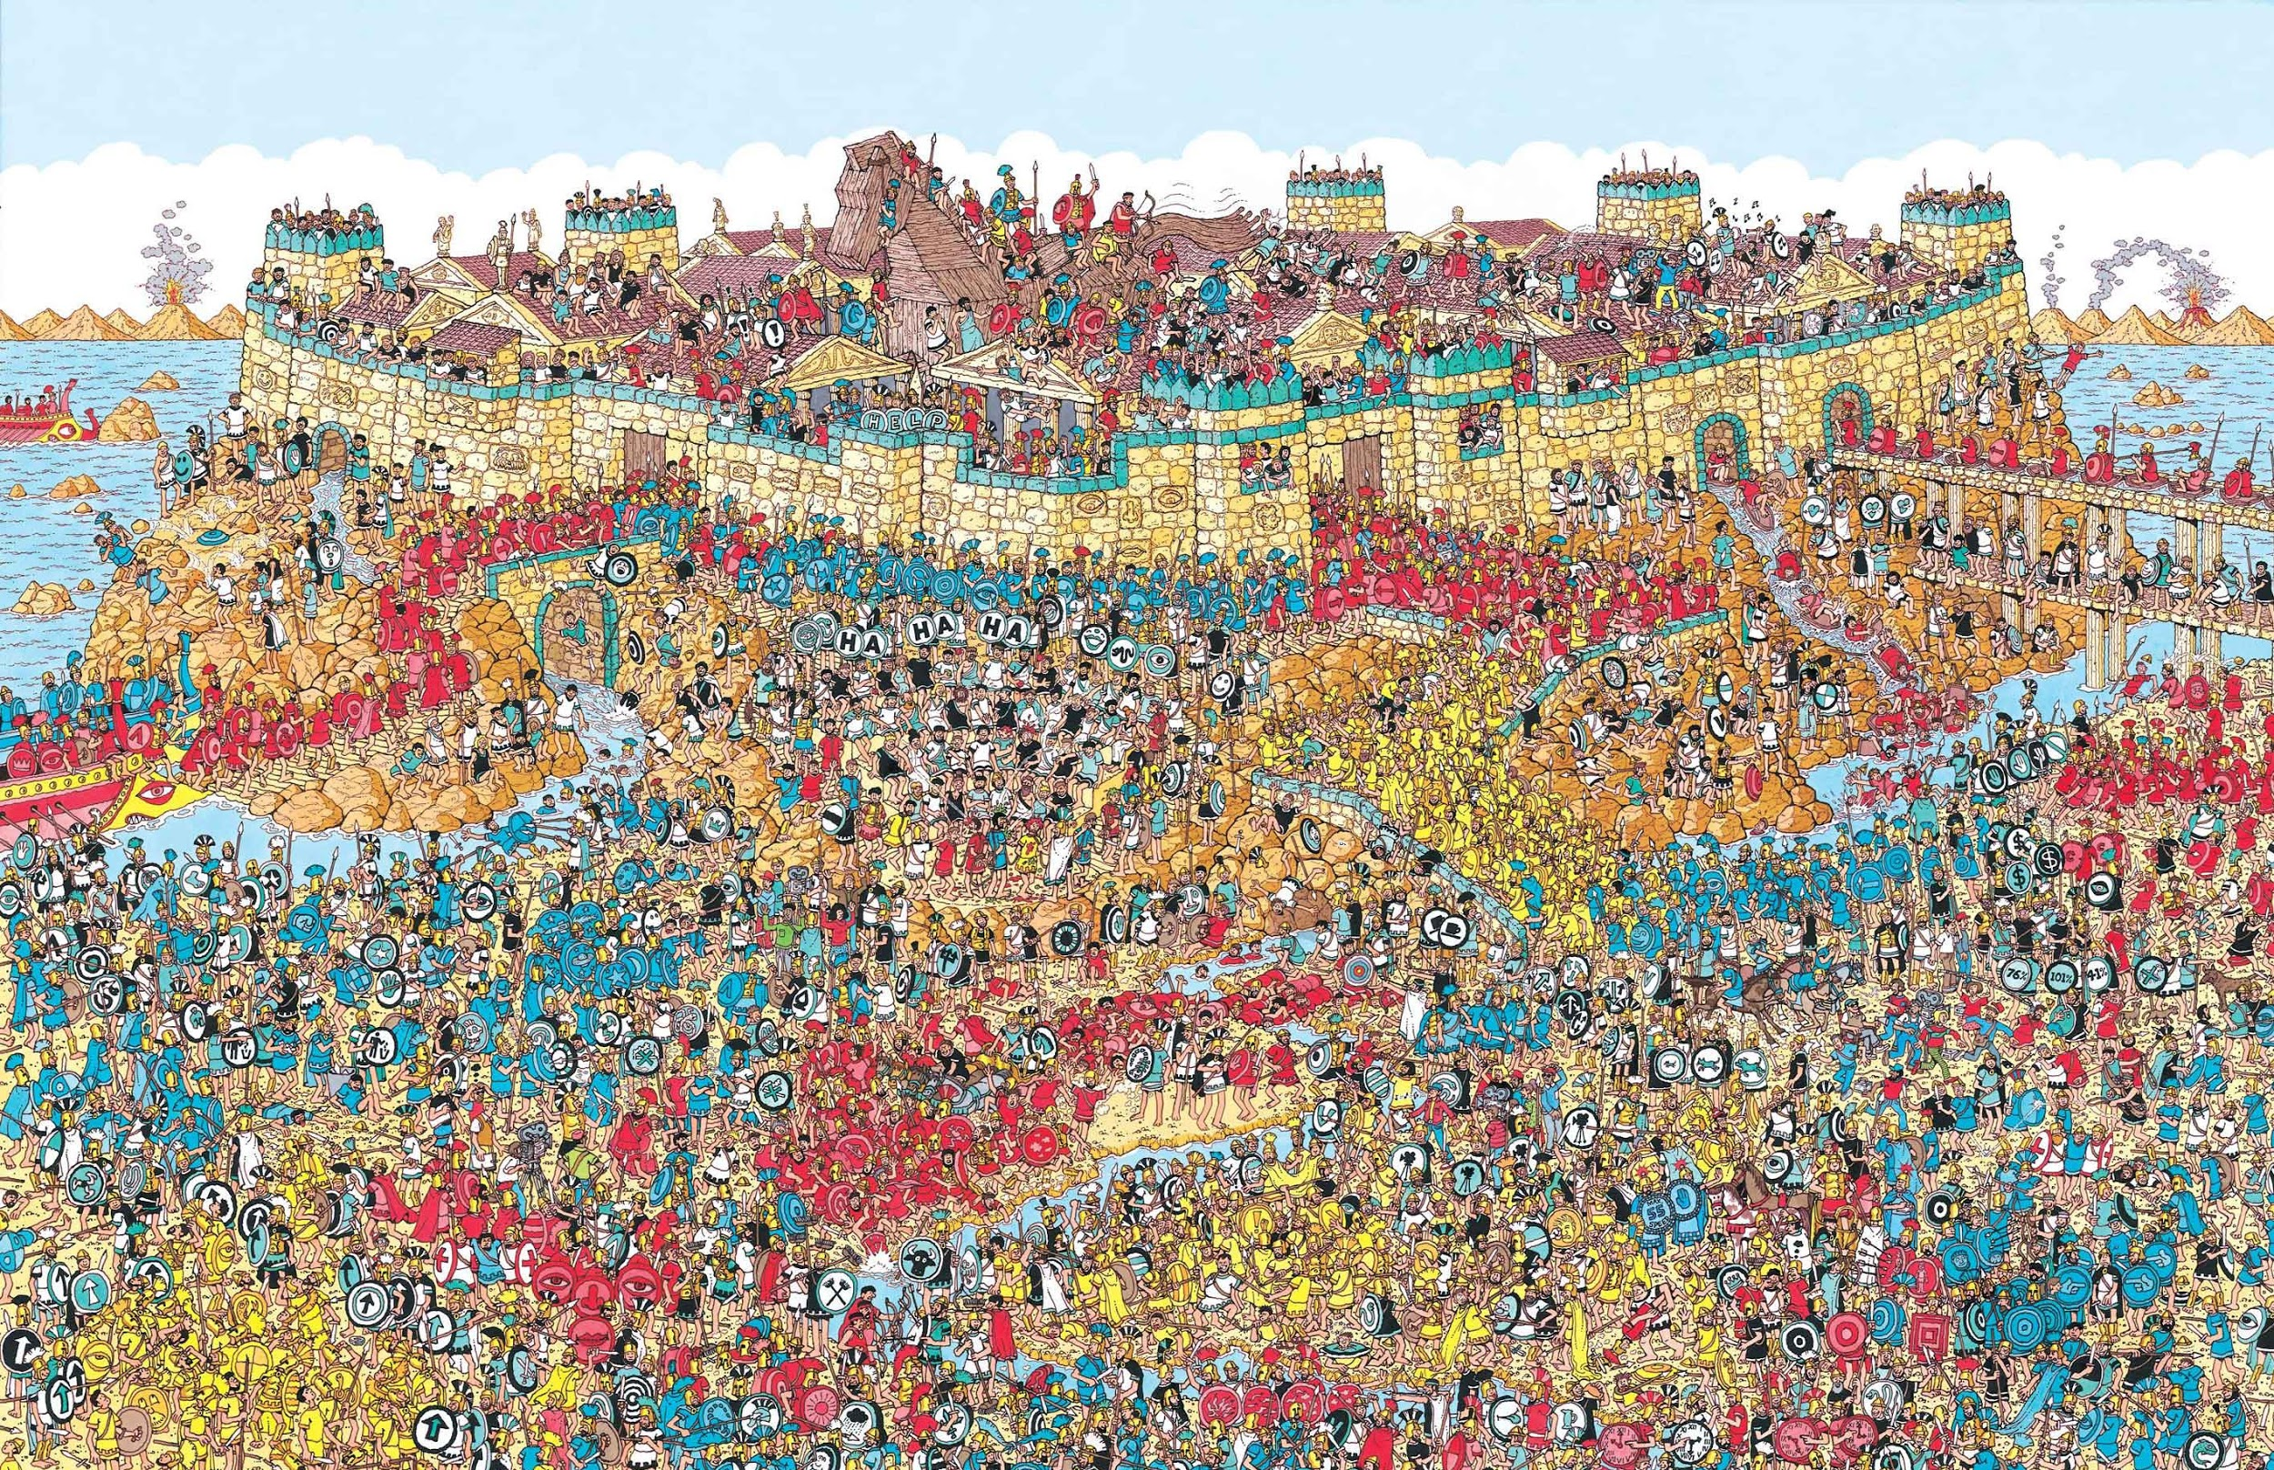
Method 1: Results
Waldo mapped in 6 out of 10 maps

Slide 11
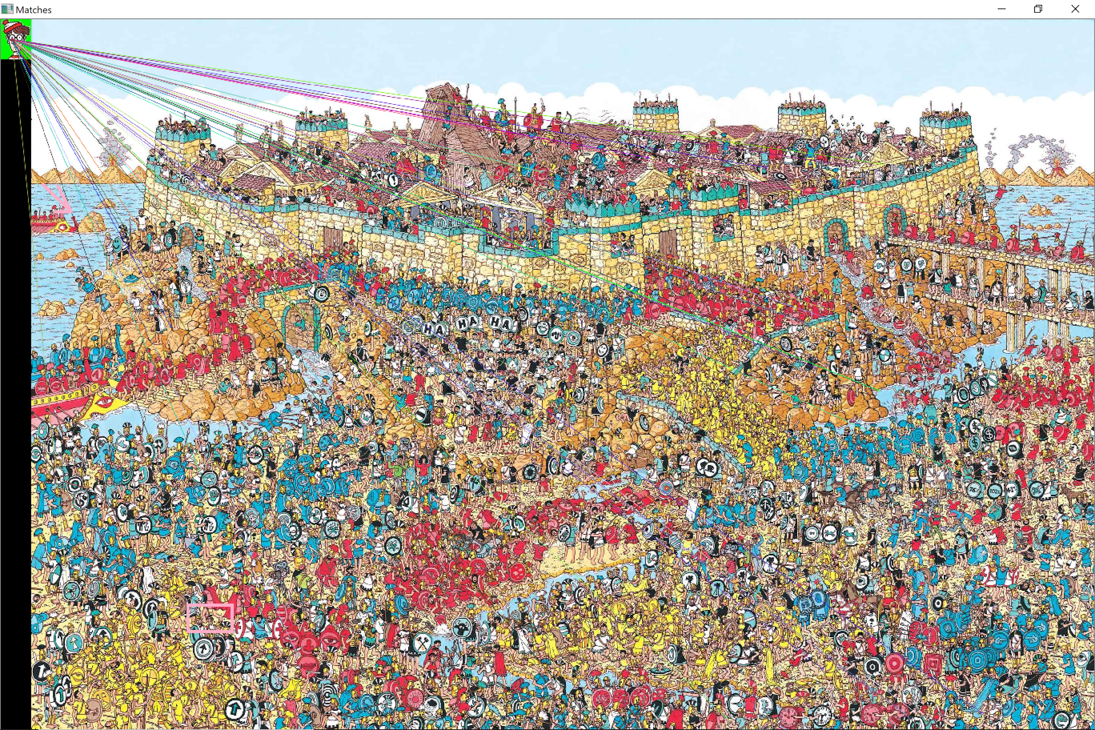
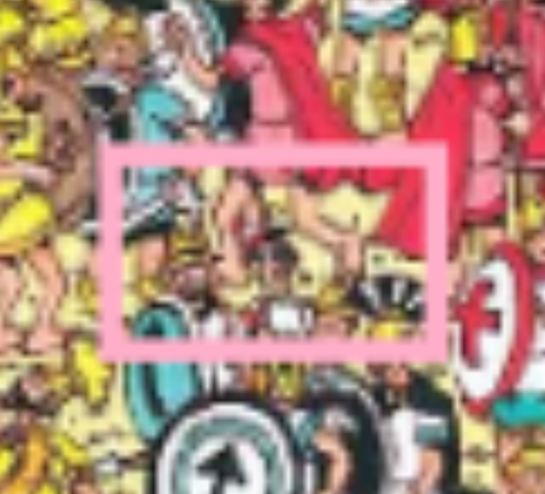
Method 1: Results

Slide 12
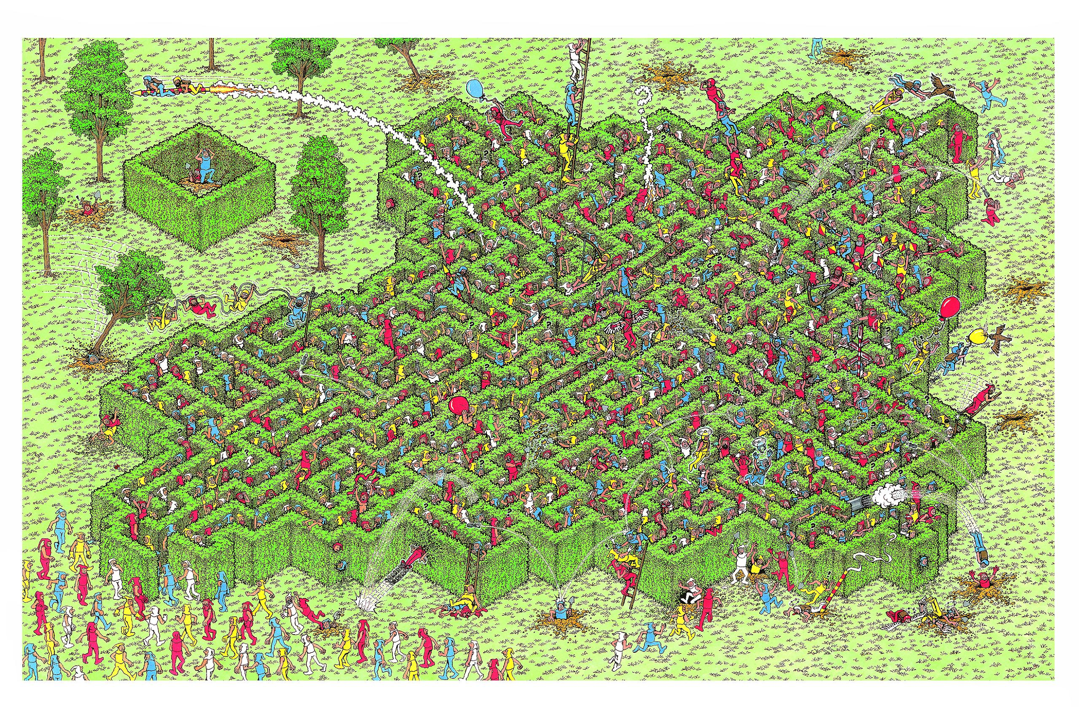
Method 1: Results
Waldo mapped in 6 out of 10 maps

Slide 13
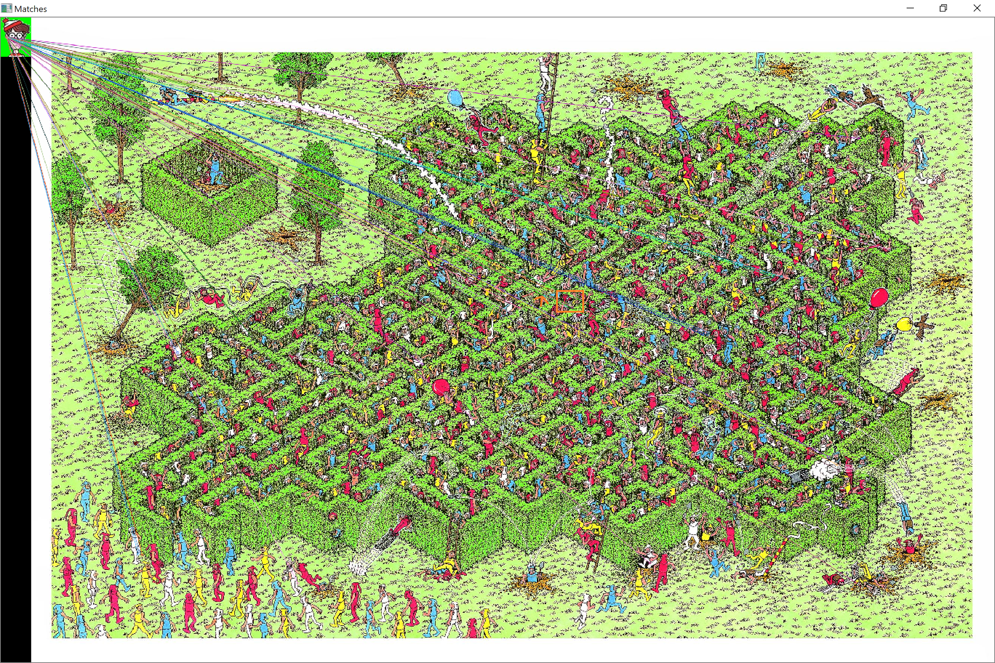
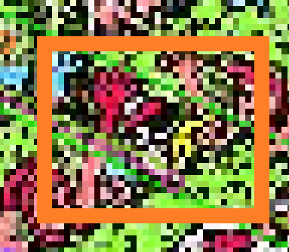
Method 1: Results

Slide 14
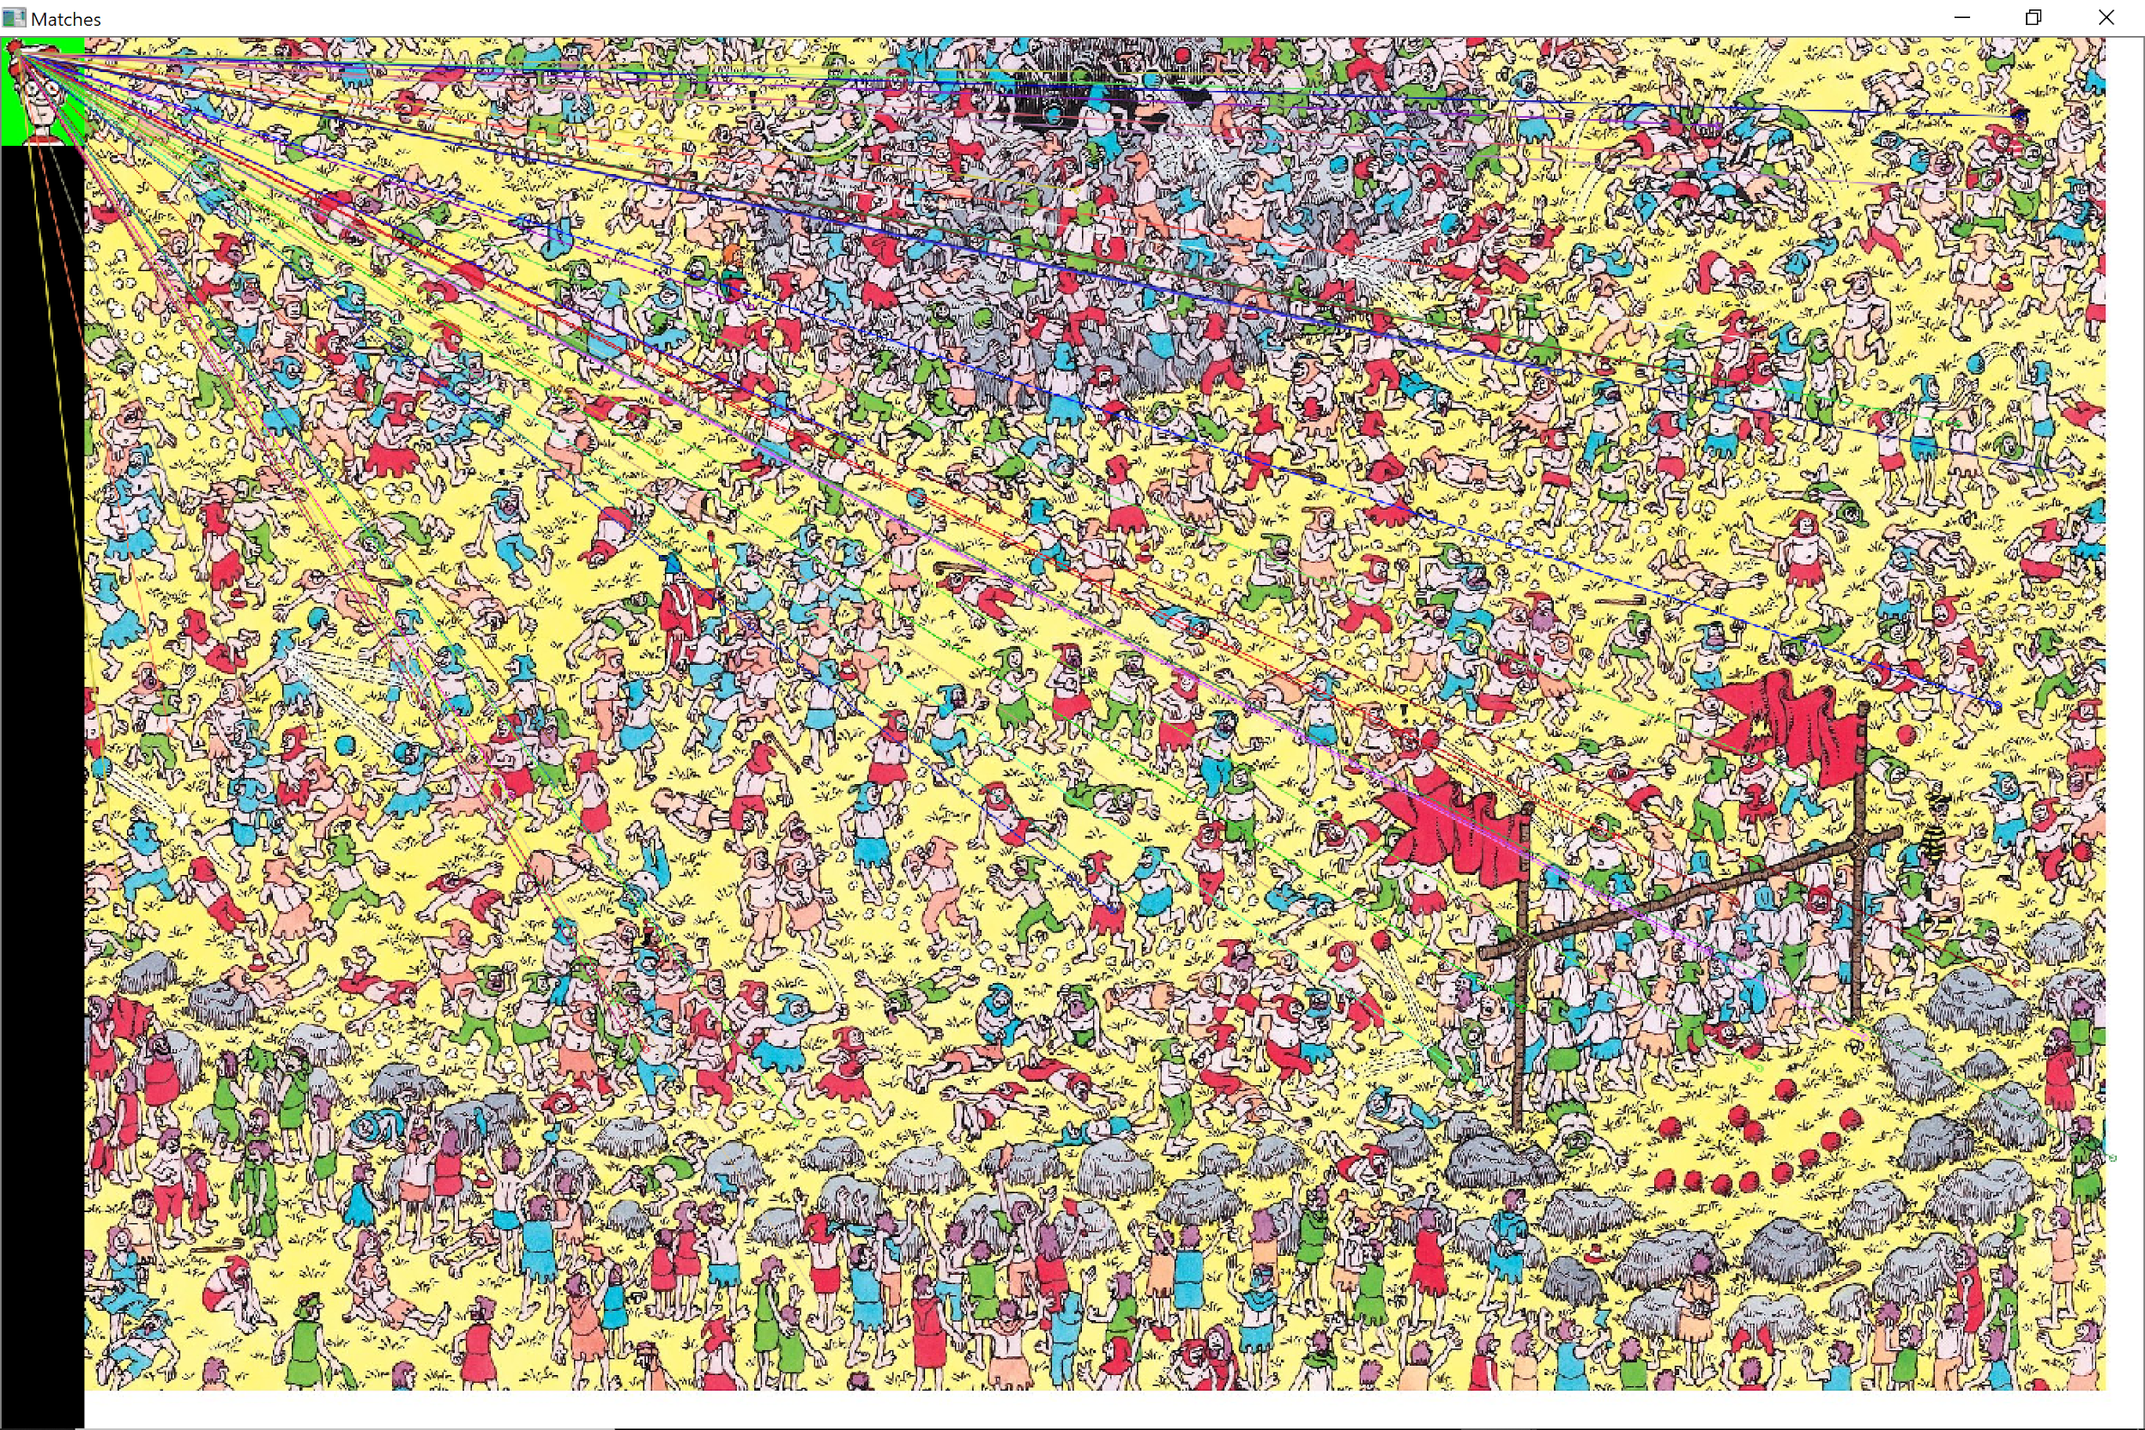
Method 1: Results
Waldo mapped in 6 out of 10 maps

Slide 15
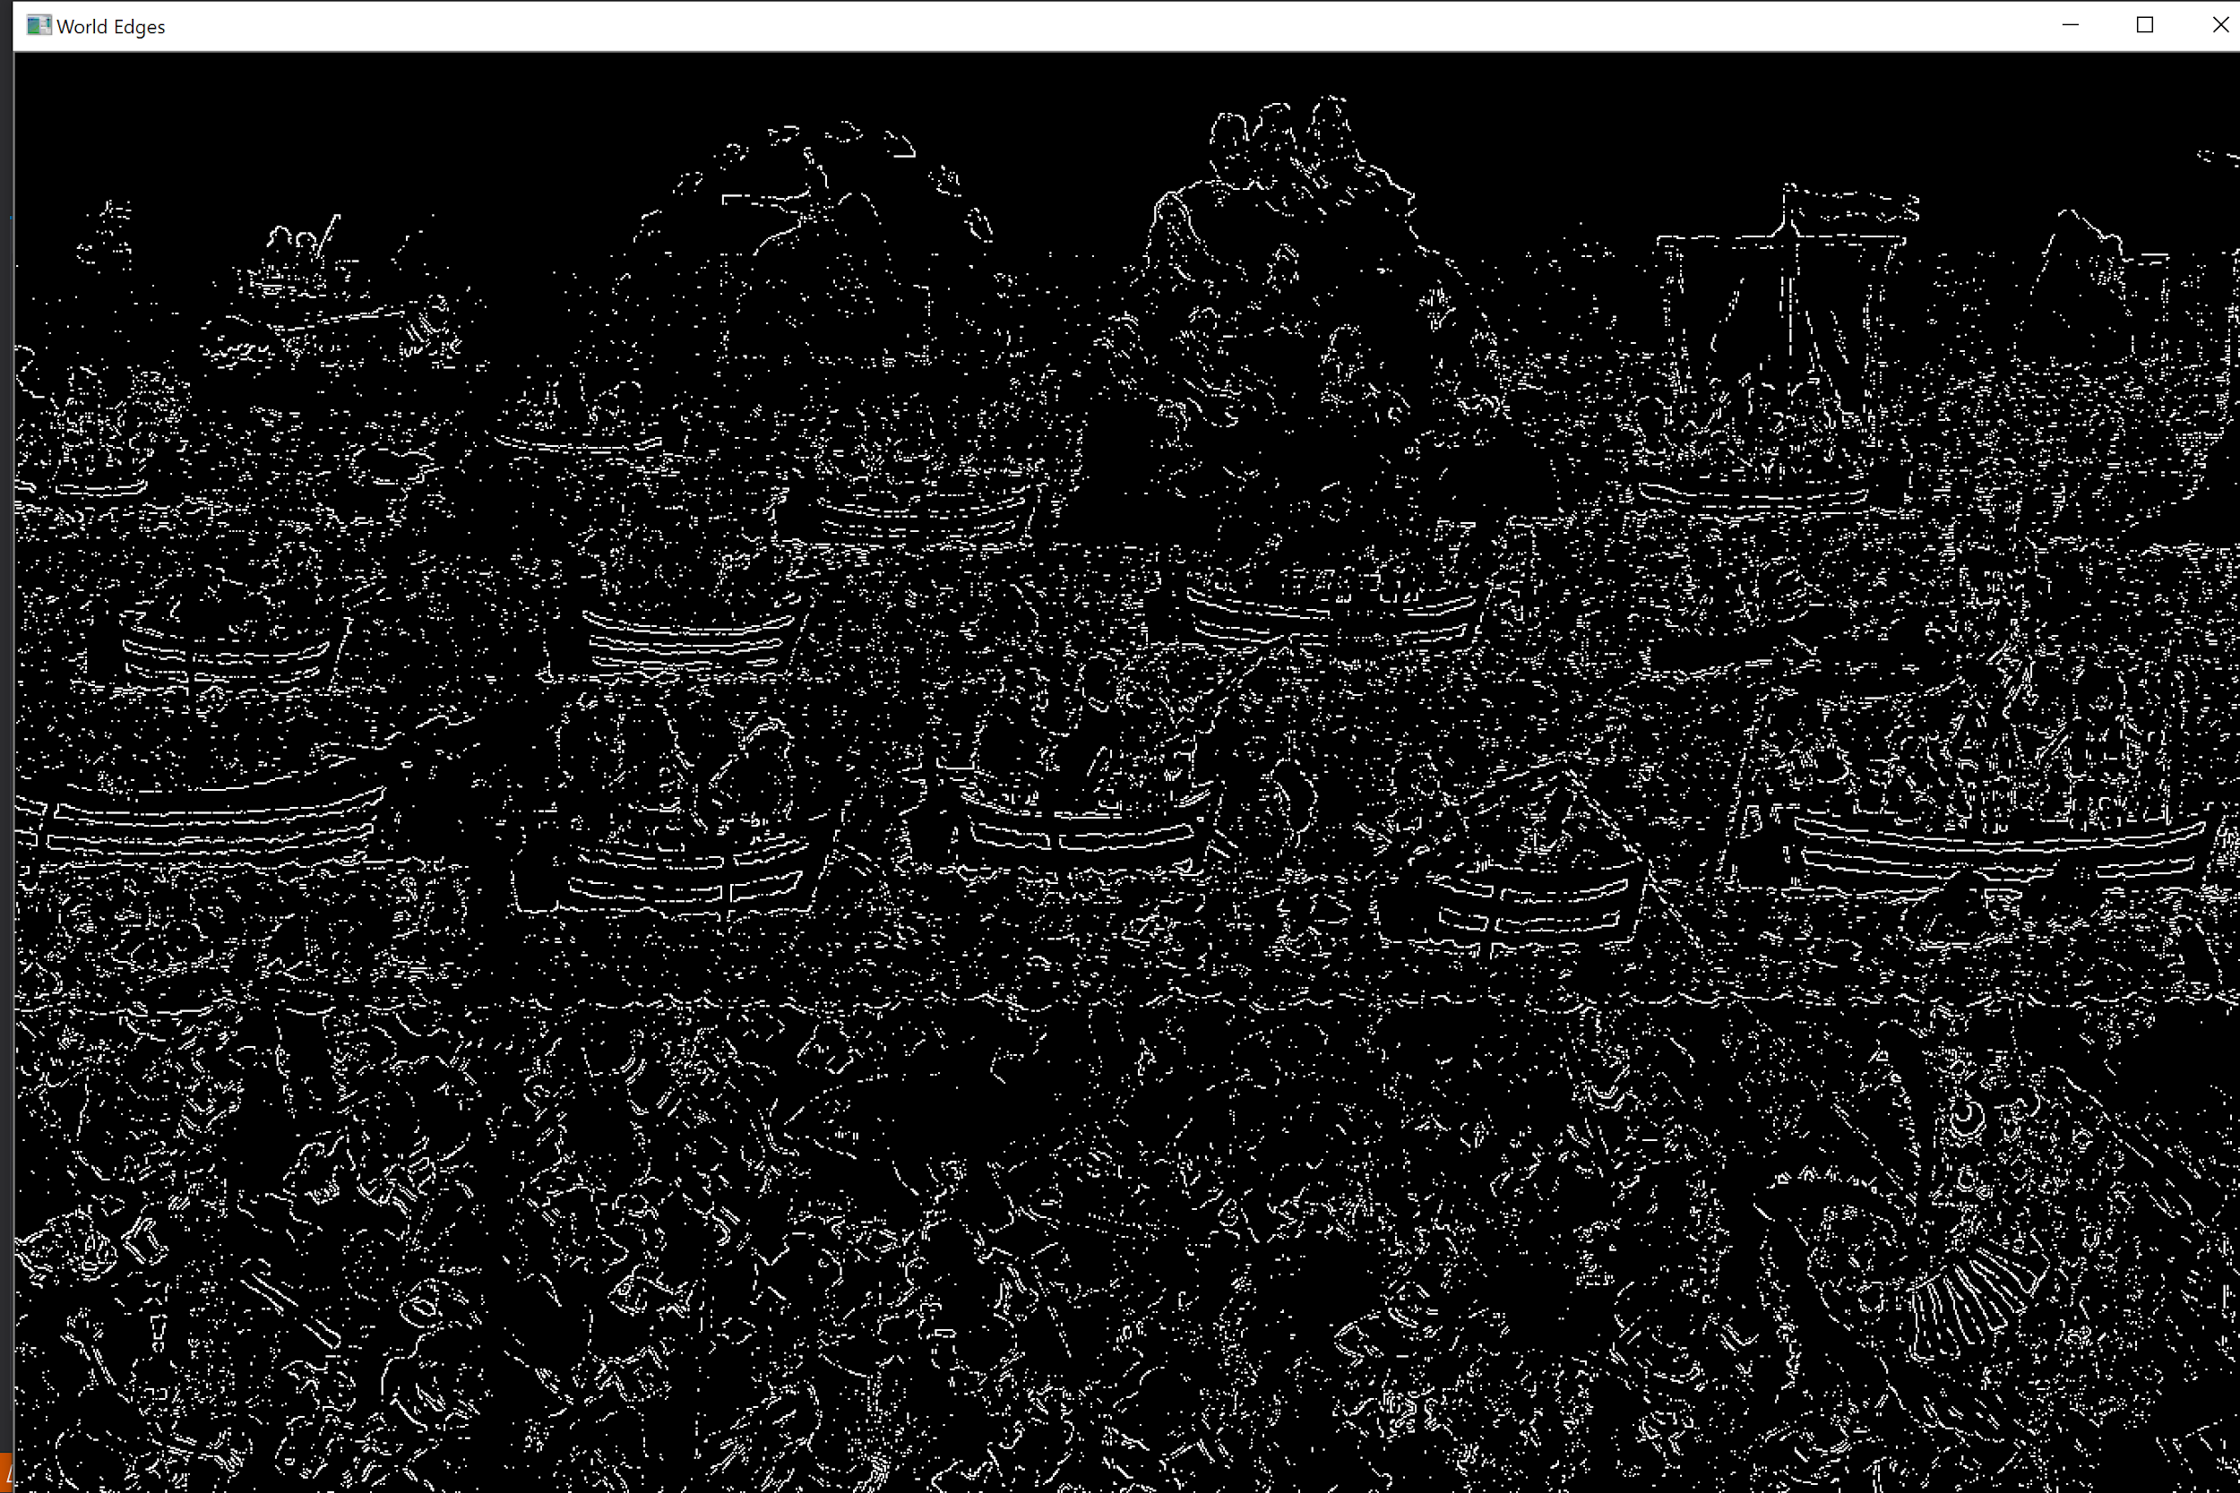
Method 1: Fail Case

Slide 16
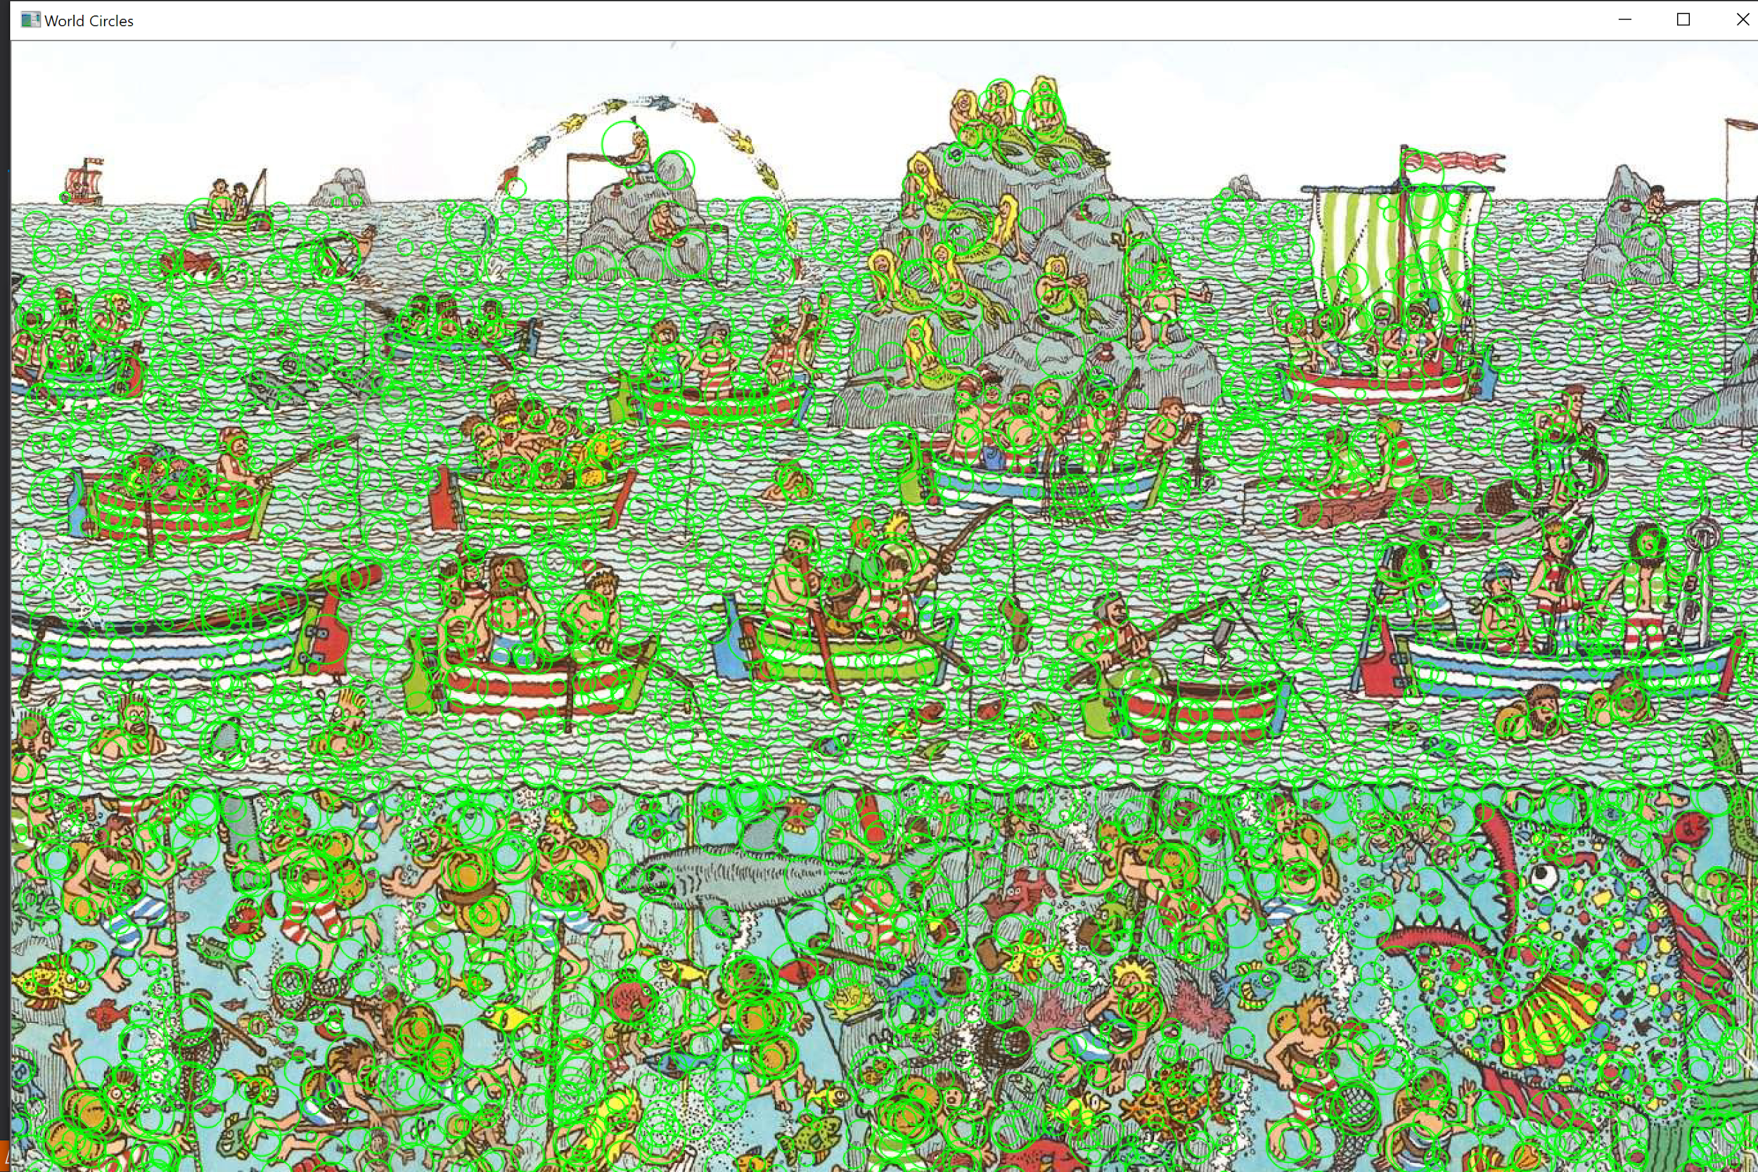
Method 1: Fail Case
At Low Resolution Mode
Circles detected without filtering

Slide 17
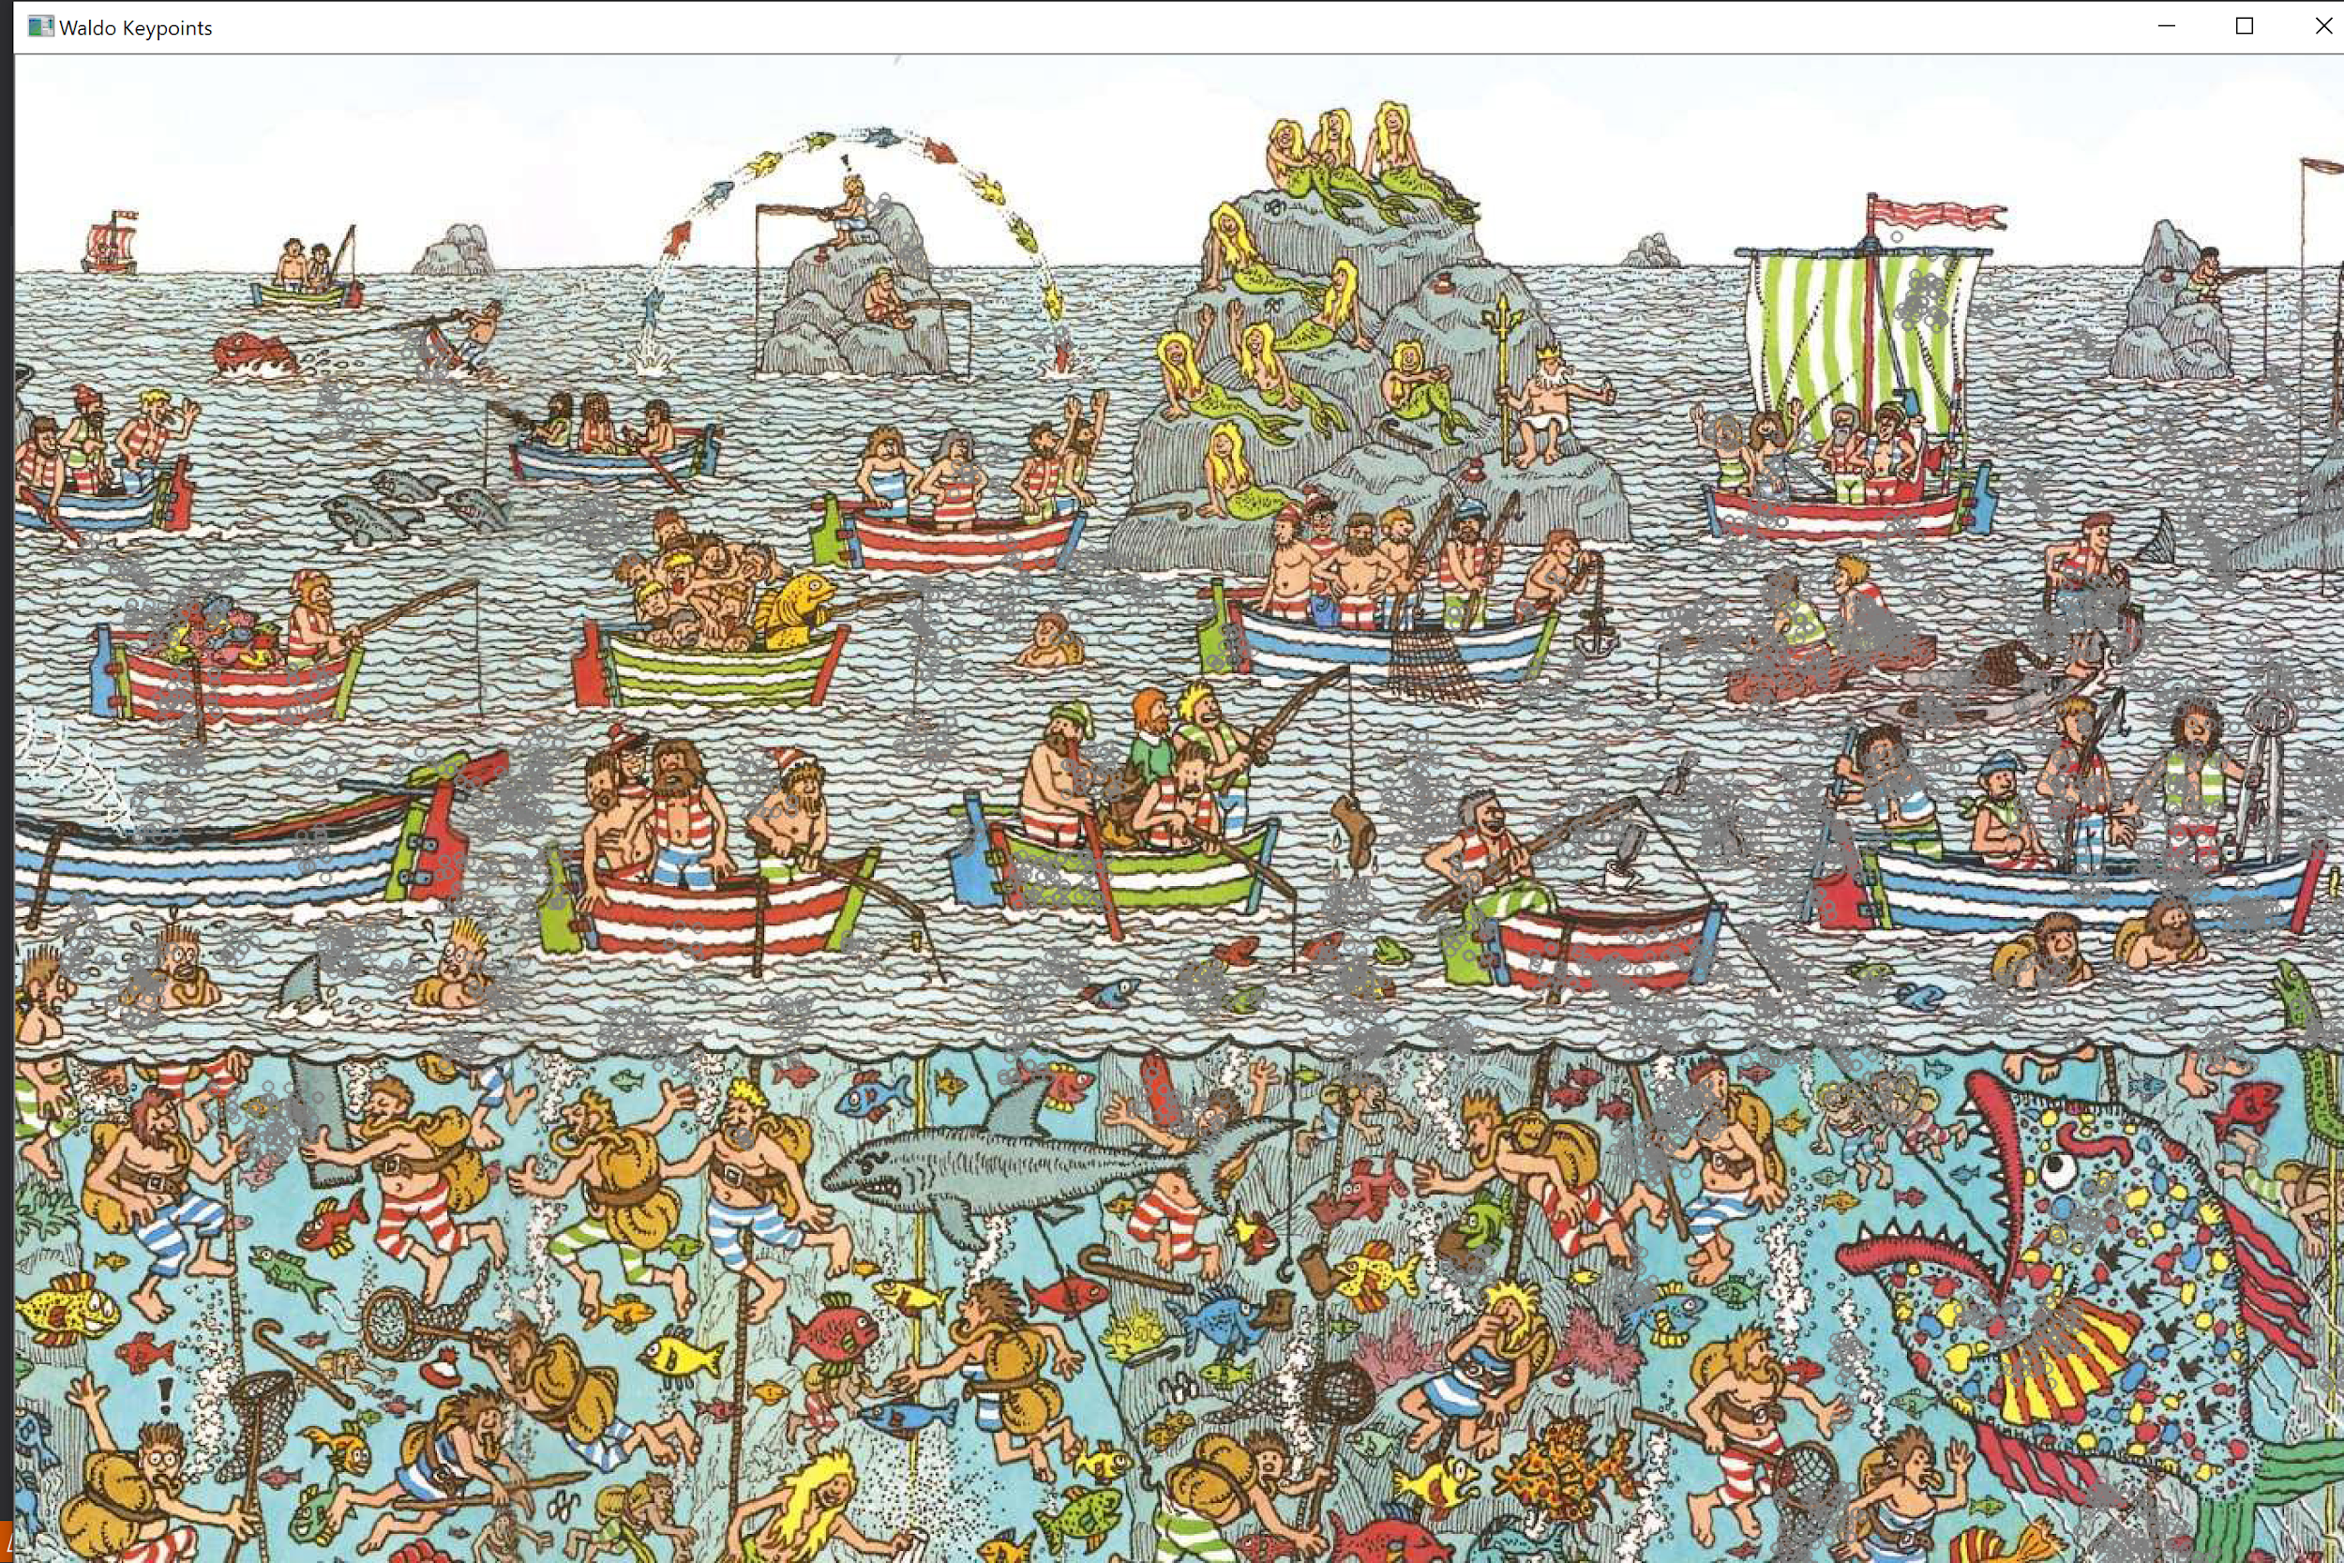
Method 1: Fail Case
After Histogram Filtering
No keypoint mapped to Waldo

Slide 18
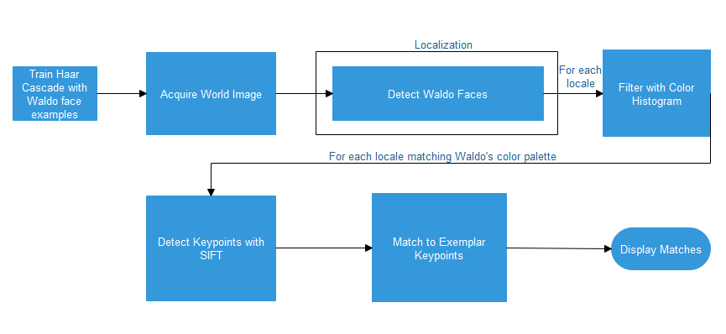
Method 2: Haar Cascade

Slide 19
Method 2: Haar Cascade Reasoning
Haar cascade is used for object detection. It is especially famous for face detection.
It is suitable for this problem because its main objective is to detect so we can localize the possible locations of waldo.
Our objective is to find faces that are similar to waldo in the image. Then use a color histograms to narrow down the search.

Slide 20
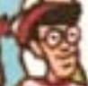
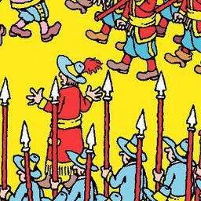
Method 2: Haar Cascade Training examples
Needs positive and negative examples

Slide 21
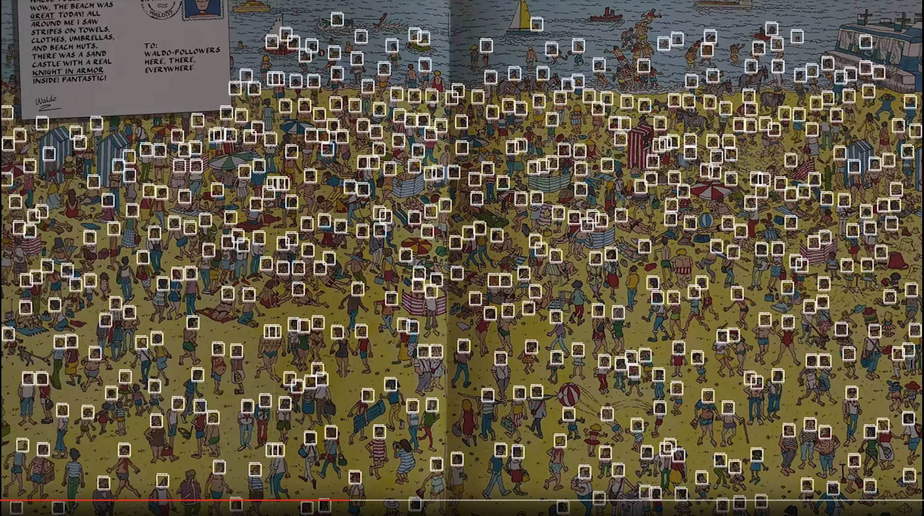
Method 2: Haar Cascade Ideal Output

Slide 22
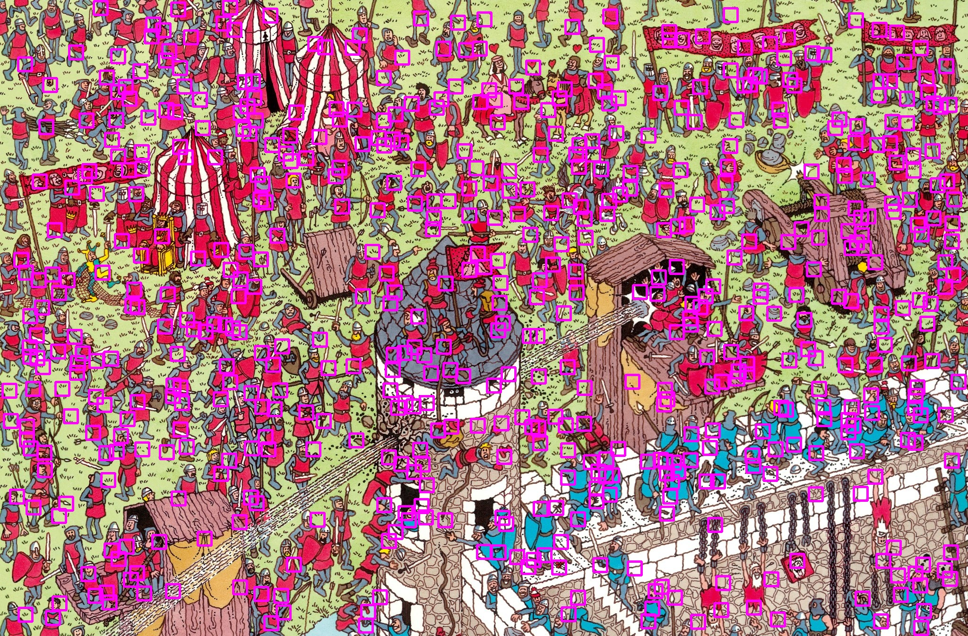
Found waldo

Slide 23
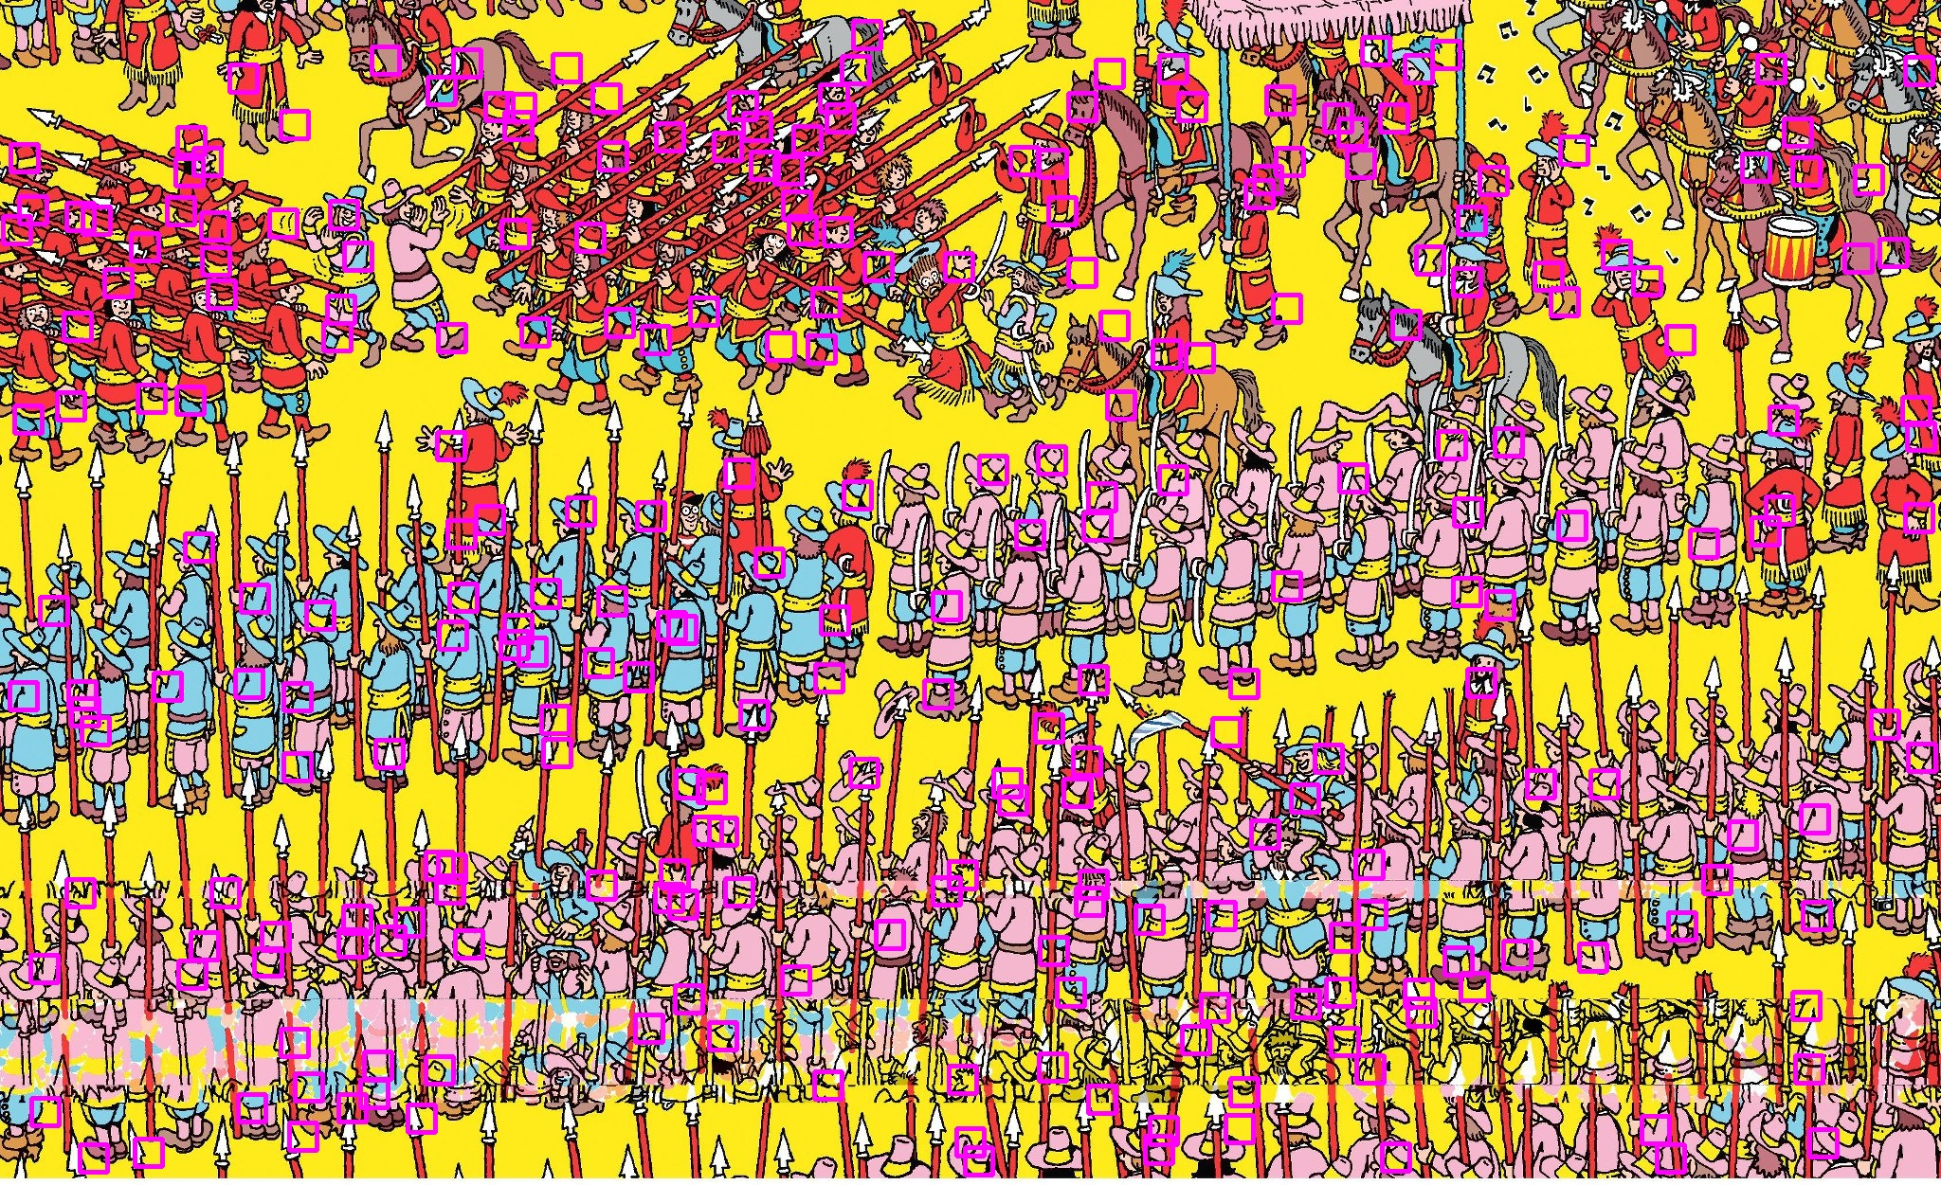
Did not find waldo

Slide 24
Future Work
Hough and SIFT:
Display the best matching result for Waldo
Instead of displaying the top 50 matches for the user to cycle through
Better circle detection
Template bank of ovals and circles
Detect glasses
Then use Pipeline approach
Haar Cascade:
Failed ⅚
Retrain on a remote linux server

